Slide 1
Predicting Future Stock Prices with LSTM Model
This presentation aims to explore the use of LSTM models in predicting future stock prices to aid investors and traders in making better-informed investment decisions.
GROUP-11
VAMSHITHA KOMPELLY
LIKITHA VADLA

Slide 2
Introduction
The main purpose of the stock market is to provide a marketplace for the buying, selling, and exchange of securities and stock.
Applying the correct stock market prediction methods helps minimize losses and improve entry/exit points.
The Long Short-Term Memory (LSTM) model is a popular and successful machine learning model used in finance, particularly for processing sequential data.

Slide 3
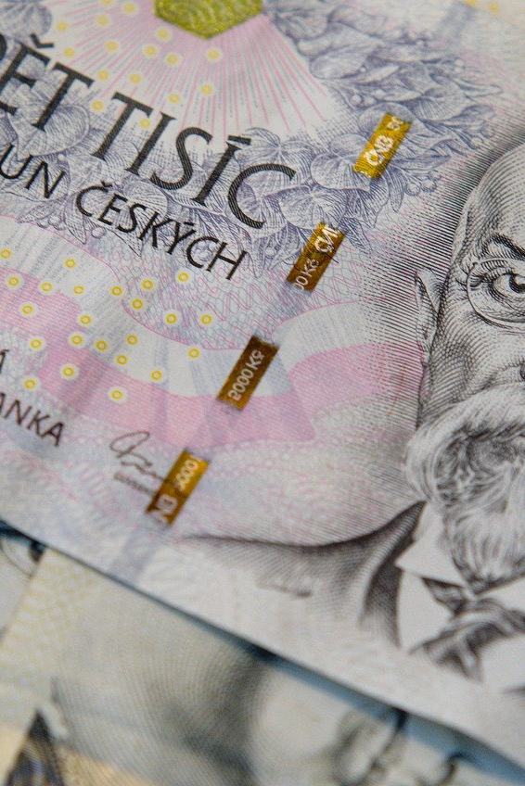
Problem Statement
Predicting future stock prices to aid in investment decision making.
Investors and traders can making better-informed investment decisions, avoid risk, and potentially improve their overall returns

Slide 4
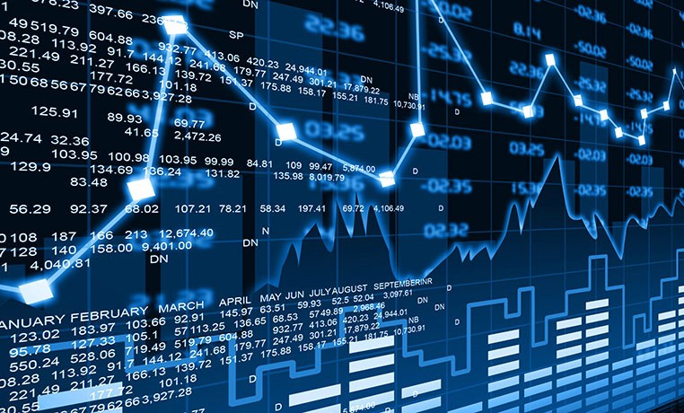
Objectives
Objective: Develop a machine learning based solution for more accurate predictions compared to traditional analysis techniques.
Benefits: Better-informed investment decisions, risk management, and potentially improved overall returns.

Slide 5
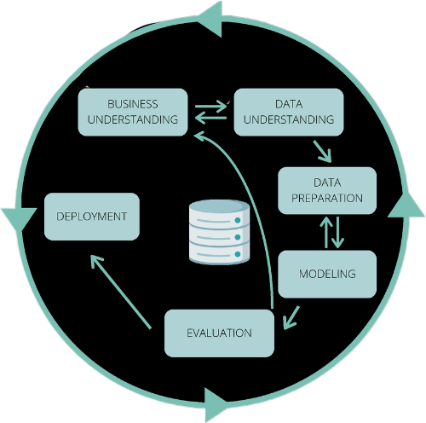
CRISP-DM

Slide 6

Business Understanding
Tools and techniques for identifying potential investment opportunities and managing risk are crucial.
Investors and traders need reliable and accurate methods to predict future stock prices.

Slide 7

Data Understanding
Using the yfinance library to download market data in a threaded and Pythonic manner.
Obtaining stock data from Yahoo Finance website, a valuable source of financial market data.

Slide 8
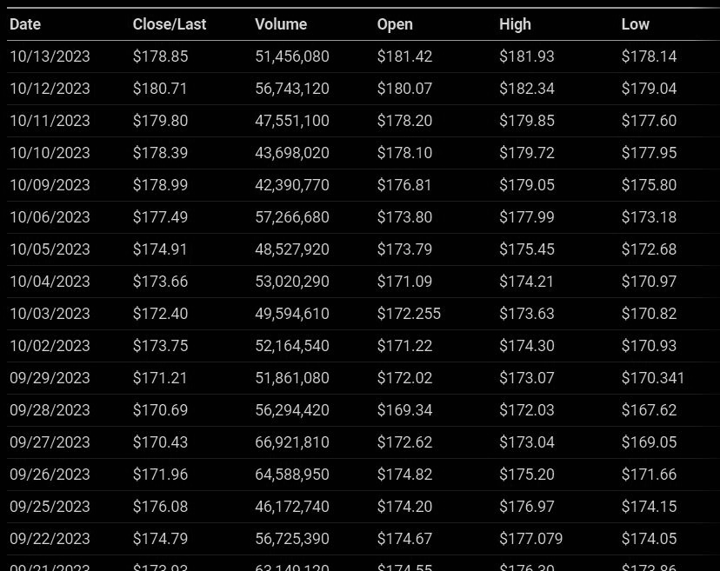

Slide 9
Data Analysis
How has the price of the stock changed over a particular period of time?
On average, what percentage return does the stock provide on a daily basis?
What is the moving average of the stock prices for a given period of time?
Is there any correlation between the prices of different stocks in the market?
What is the level of risk involved in investing in a particular stock?
Using an LSTM model, how accurately can we predict the closing stock price of a company in the future?

Slide 10
Data Preparation
Clean and preprocess the data to remove any discrepancies or missing values.
Normalize or scale the data to ensure that the model can effectively learn from the features without being affected by large variations in value.
Extract relevant features from the data that could help in predicting future stock prices.

Slide 11
Modeling
Design an LSTM neural network architecture, which may consist of one or more LSTM layers, followed by Dense layers and a final output layer.
The output layer will have a linear activation function, as we're predicting a continuous value i.e stock price.
Train the LSTM model using the training dataset by minimizing a suitable loss function (e.g., mean squared error) and optimizing the weights with a suitable optimizer.

Slide 12


Evaluation
Evaluate the model's performance using appropriate metrics, such as Mean Absolute Error (MAE) or Root Mean Squared Error (RMSE), to measure how well the model is predicting the stock prices on the validation set.

Slide 13

Deployment
Deploy the application on cloud platforms such as AWS.
Create a RESTful API or web service using a suitable framework like Flask, FastAPI, or Django for Python.
This API will serve as the interface between the users and the LSTM model.

Slide 14
Conclusion
Machine Learning and its algorithms have revolutionized stock market analysis.
The Opening Value of the stock, the Highest and Lowest values of that stock on the same day, as well as the Closing Value at the end of the day are all indicated for each date.
The total volume of the stocks in the market is provided; with this information, it is up to the job of a Machine Learning Data Scientist to look at the data and develop different algorithms that may help in finding appropriate stocks values.
With the right data and algorithms, accurate predictions can be made for stock values.
Stock Price Prediction using machine learning techniques has become more efficient and effective.

Slide 15

Thank you 😄

